Slide 1
Generalized pMRI
Jaeeun Lee
2018/07/20

Slide 2
Contents
Implementation
Direct inversion
Image domain inversion
SMASH
Hybrid
Encoding matrix inversions

Slide 3
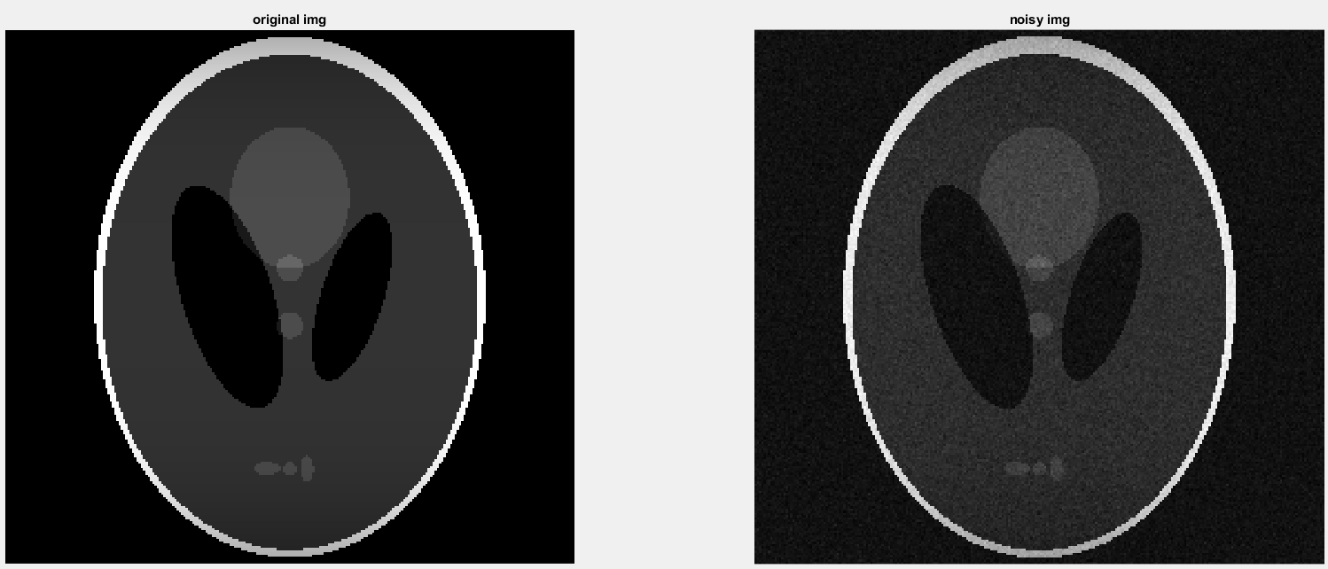
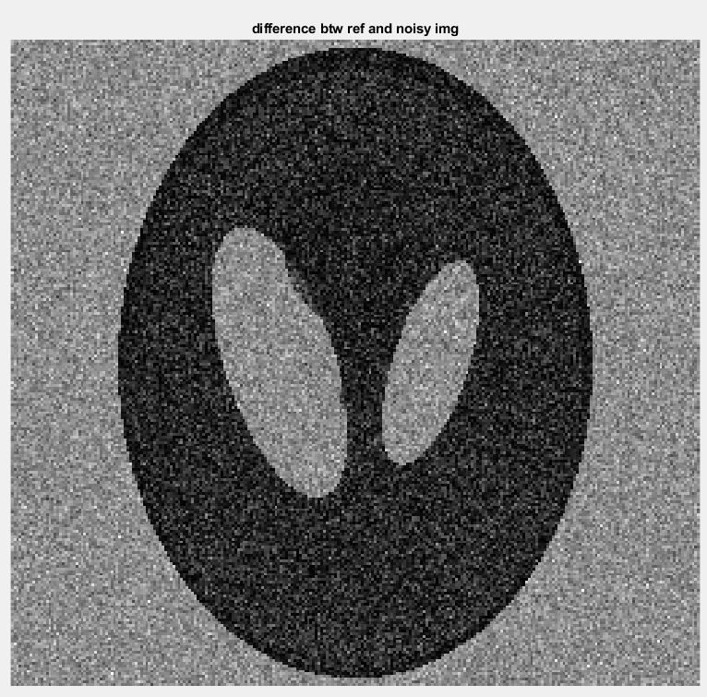
Implementation_

Slide 4
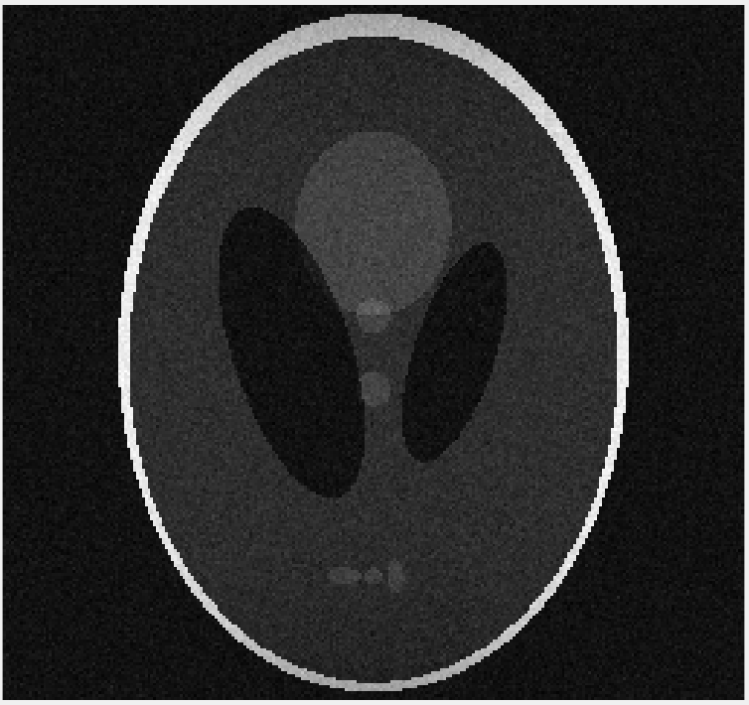
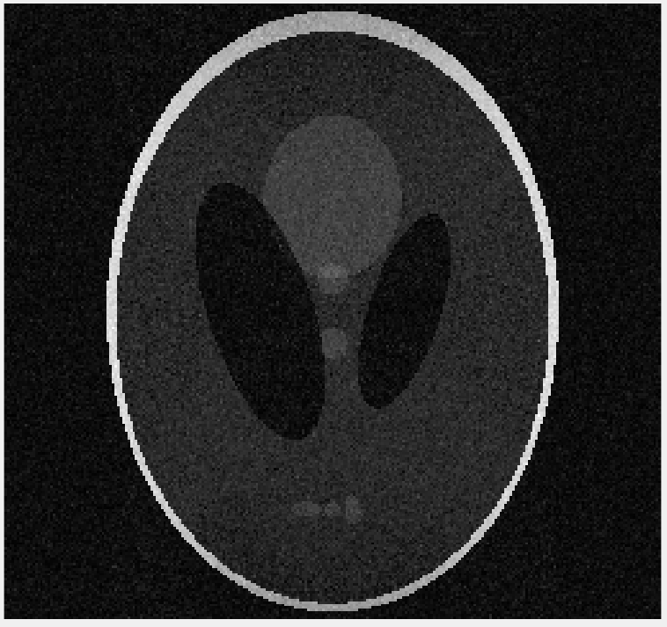
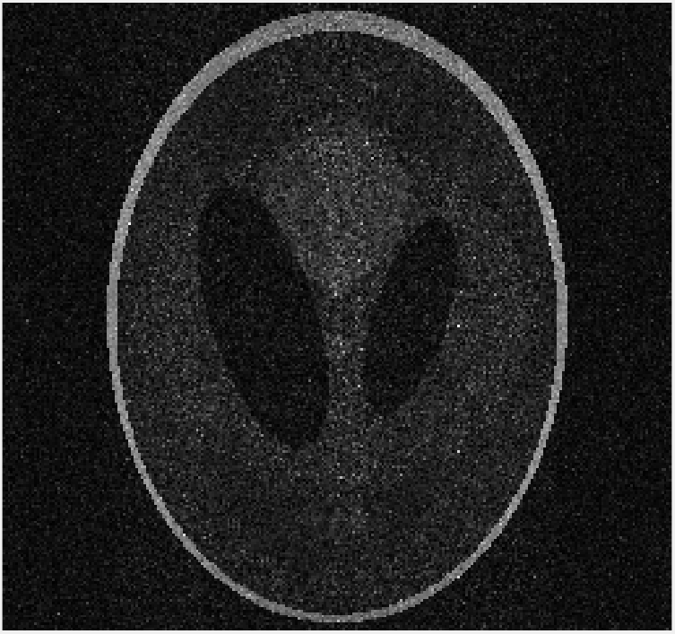
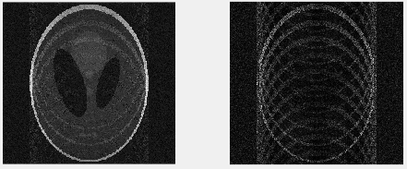
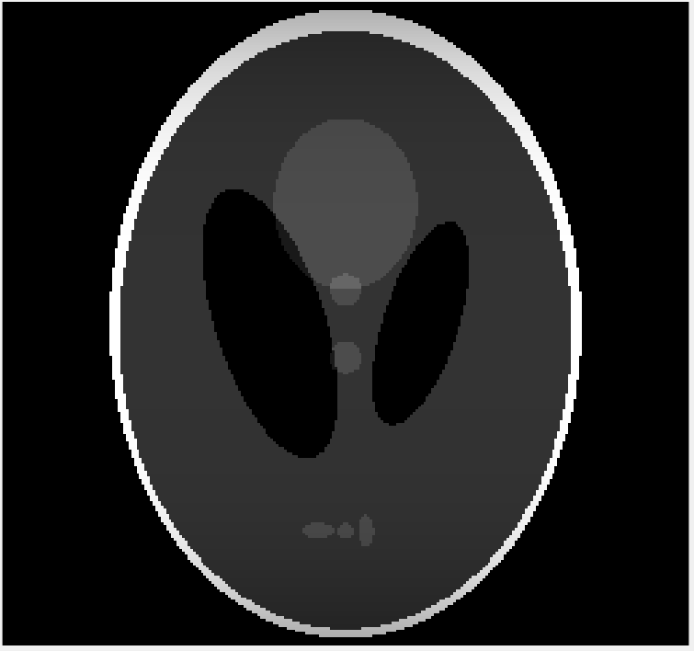

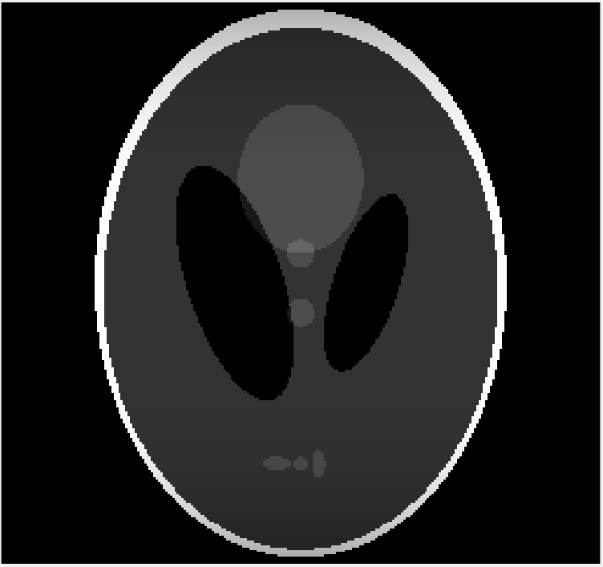
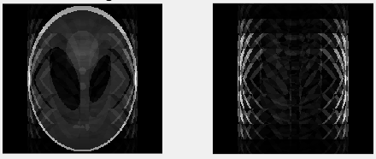
Implementation_ a. Direct inversion
Reduction factor
reference
2
5
10
Noisy data
Idx = 120 ~ -119
Raw data
Idx = 120 ~ -119

Slide 5
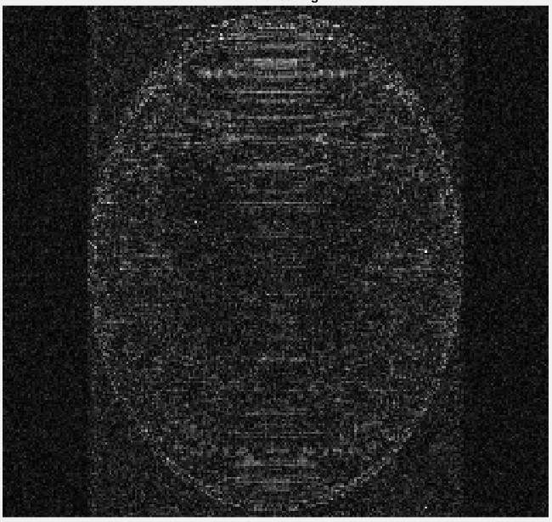
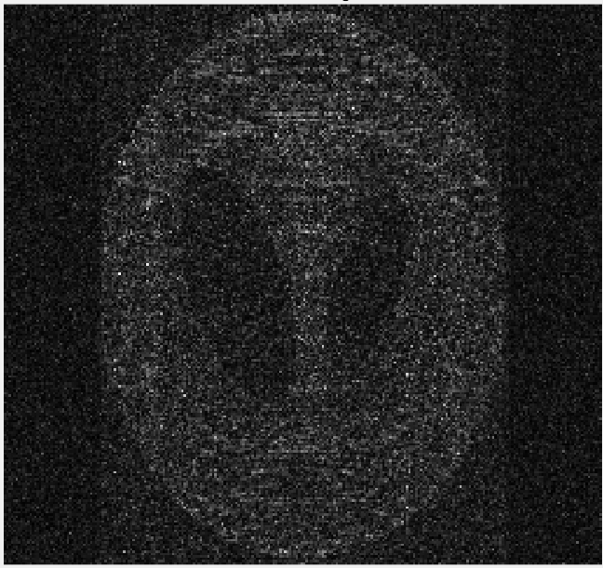
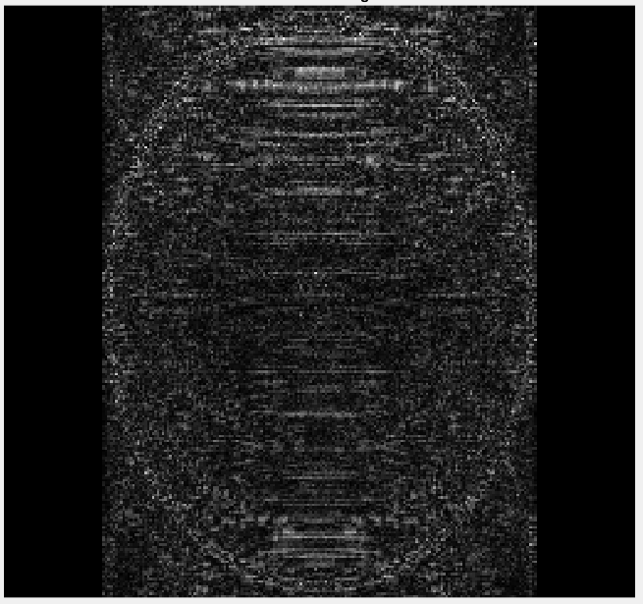
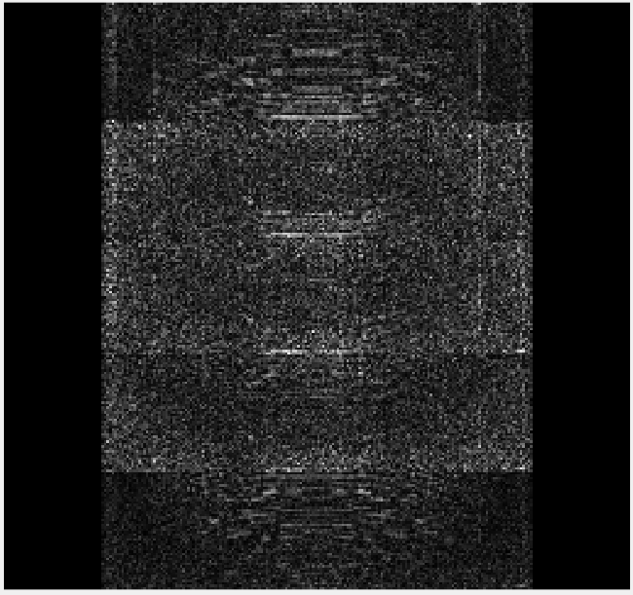
Implementation_ a. Direct inversion
Reduction factor
reference
2
5
10
Noisy data
Idx = 120 ~ -119
Raw data
Idx = 120 ~ -119

Slide 6
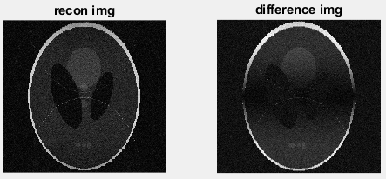
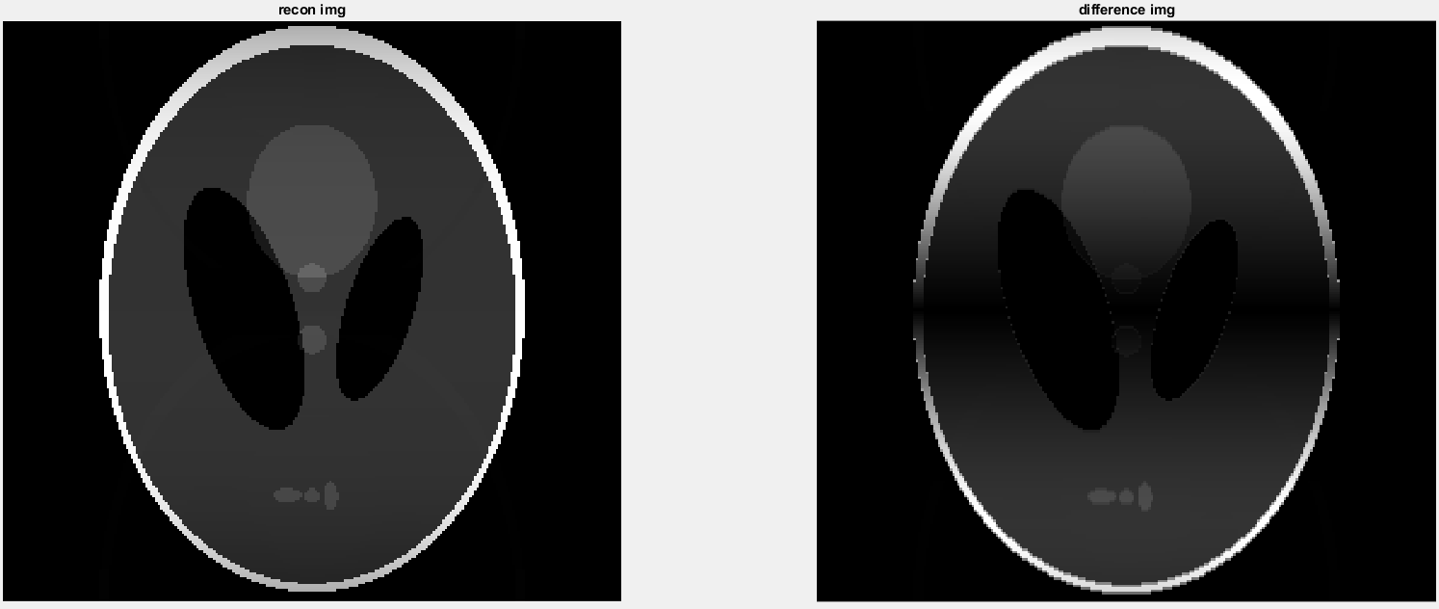
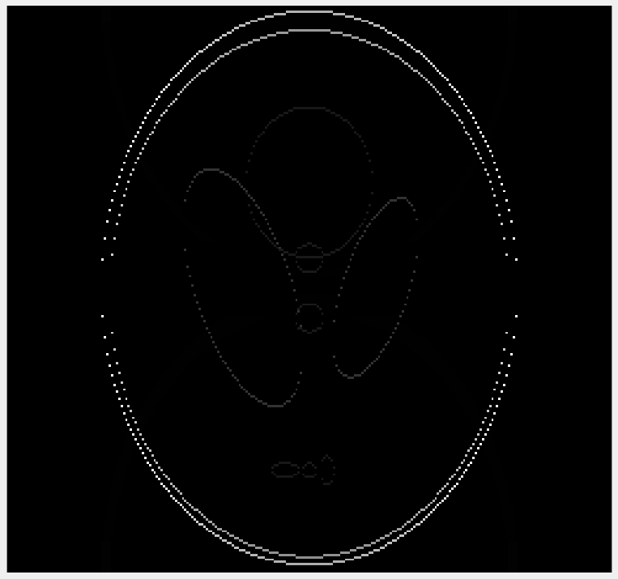
Implementation_ a. Direct inversion
Reduction factor = 2
reference
Recon img
Difference img
Noisy data
Idx = 119 ~ -120
abs(ref_img) – abs(recon_img)
Raw data
Idx = 119 ~ -120

Slide 7
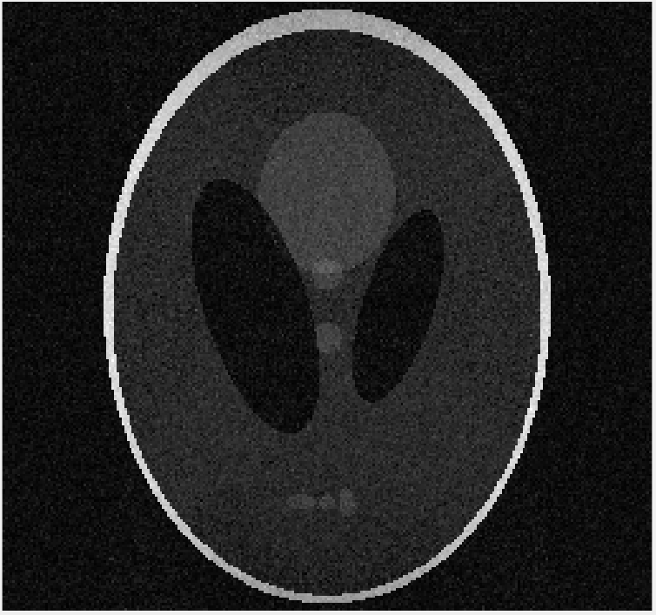
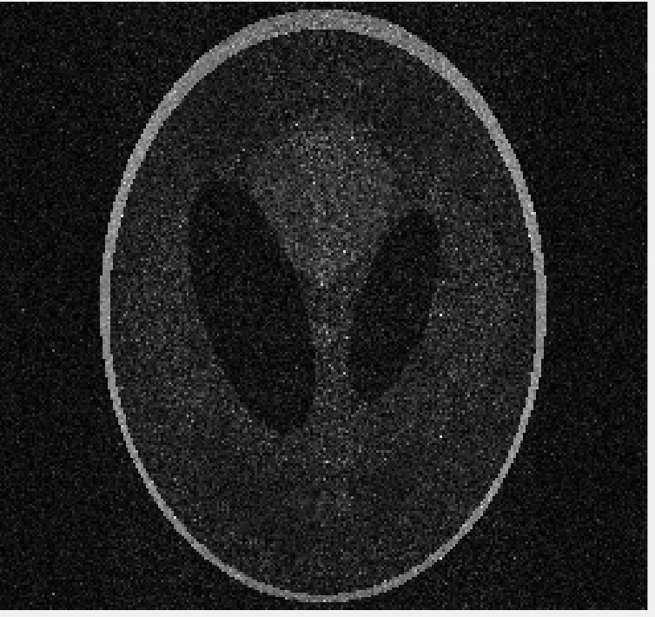
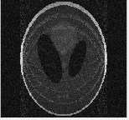
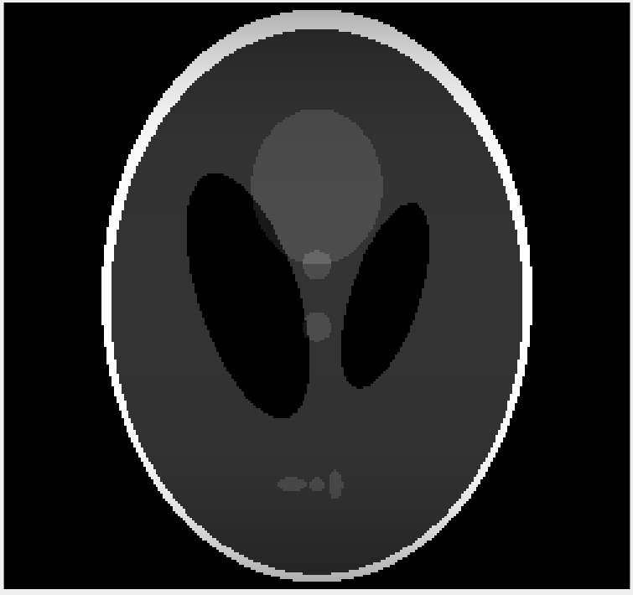
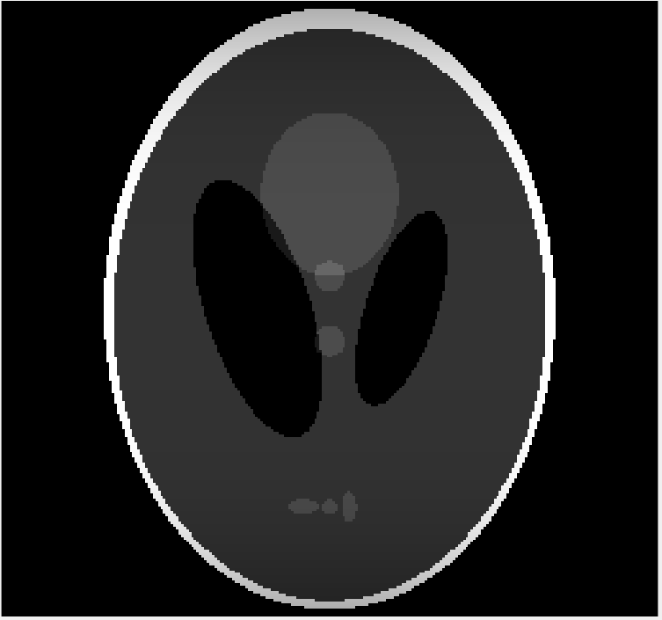
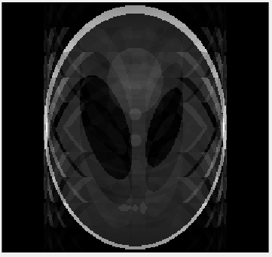
Implementation _ b. Image domain inversion(line by line)
Implementation _ b. Image domain inversion(line by line)
Reduction factor
reference
2
5
10
Noisy data
Raw data

Slide 8
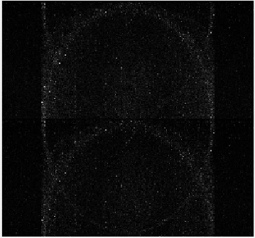
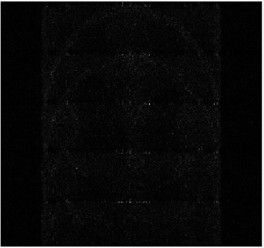
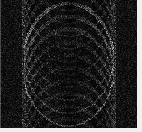
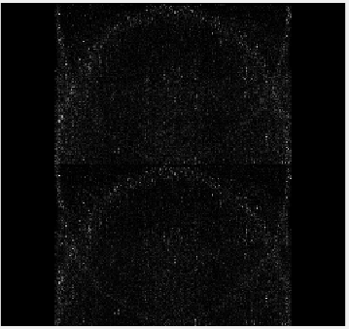
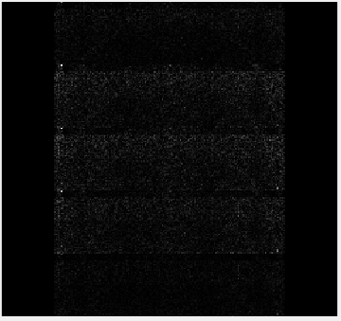
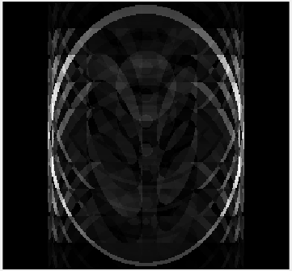
Implementation _ b. Image domain inversion(line by line)
Reduction factor
reference
2
5
10
Noisy data
Raw data

Slide 9
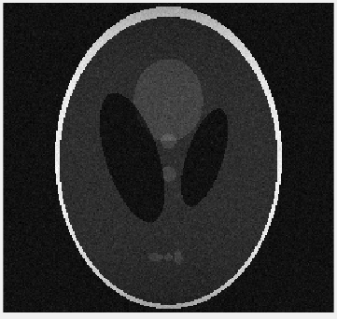
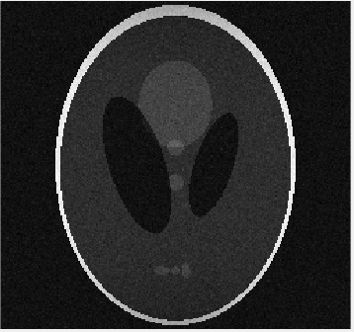
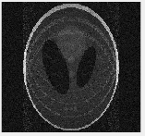
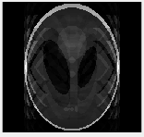
Implementation _ b. Image domain inversion(pixelwise)
Reduction factor
reference
2
5
10
Noisy data
Raw data

Slide 10
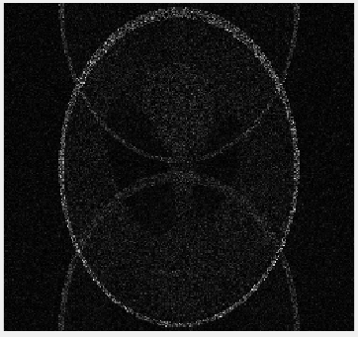
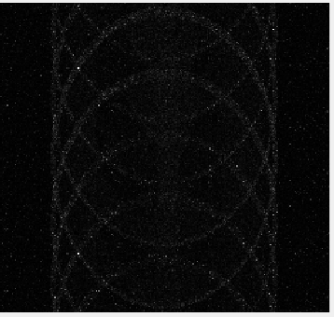
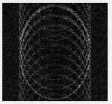
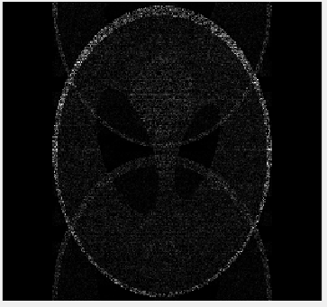
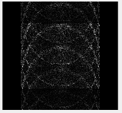
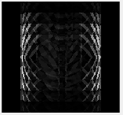
Implementation _ b. Image domain inversion(pixelwise)
Reduction factor
reference
2
5
10
Noisy data
Raw data

Slide 11
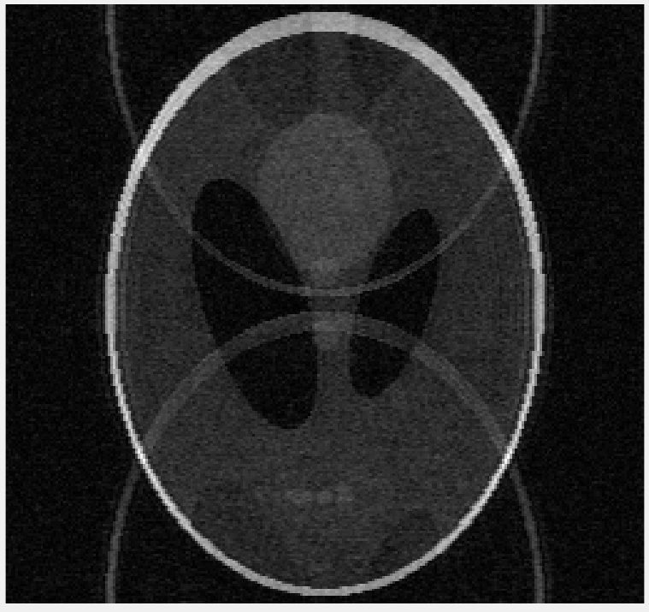
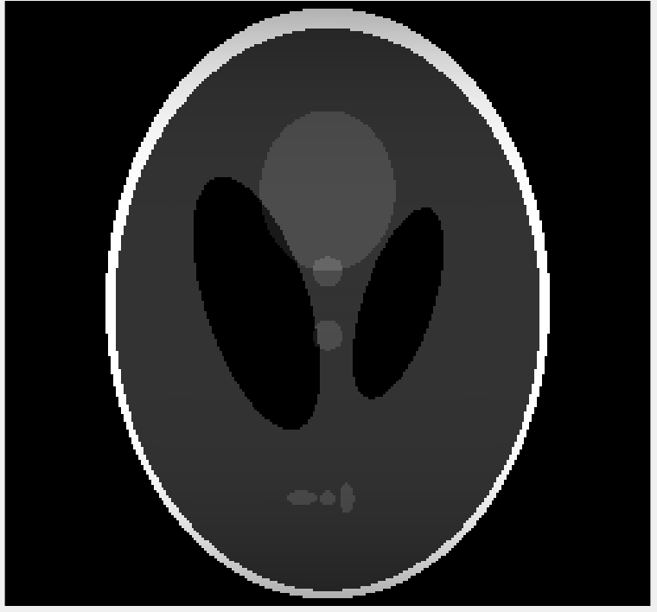
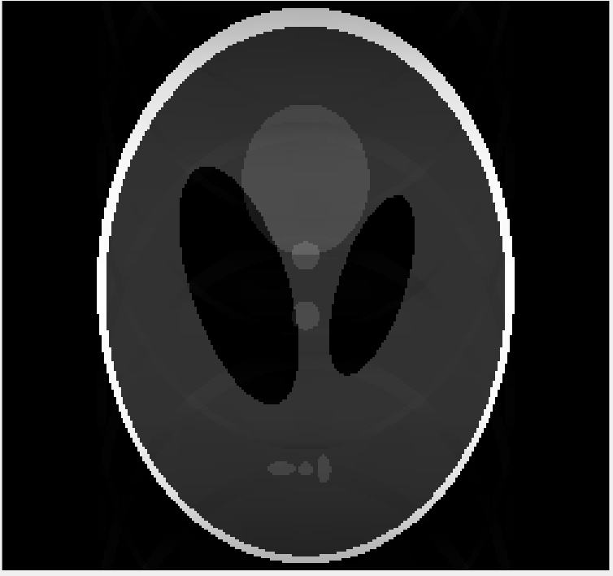
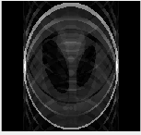
Implementation _ c. SMASH
Reduction factor
reference
2
5
10
Noisy data
Raw data

Slide 12
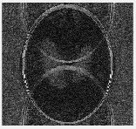
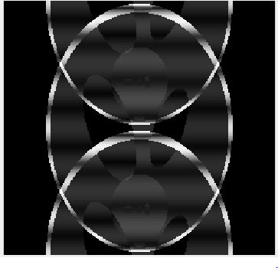
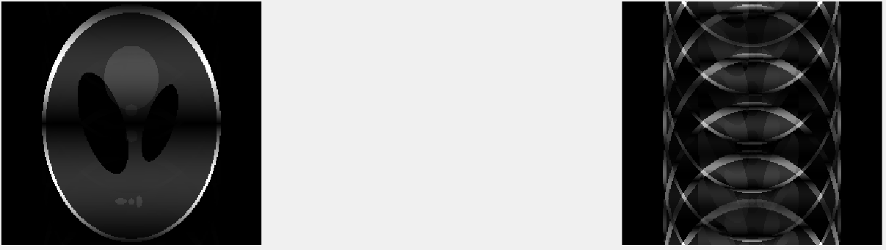
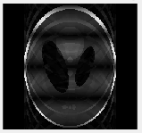
Implementation _ c. SMASH
abs(ref_img – recon_img)
Reduction factor
reference
2
5
10
Noisy data
Raw data

Slide 13
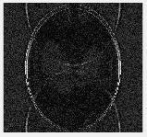
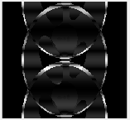
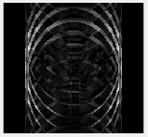
Implementation _ c. SMASH
abs(ref_img) – abs(recon_img)
Reduction factor
reference
2
5
10
Noisy data
Raw data

Slide 14



Encoding matrix inversions _
If the inverse of the square matrix $B^{∗}B$ exists, the Moore-Penrose pseudoinverse is
$$B_{pseudo}^{−1}={\left(B^{∗}B\right)}^{−1}B^{∗}$$
$$B=UΣV^{∗}$$
$$= VΣ^{−1}U^{∗}$$
It is least square fitting problem -> yield the highest possible SNR
SNR depends on the magnitudes of the weight factors used in reconstruction
Pseudo inverse : one of the process that minimize the SNR and noise amplification (Weak recon)

Slide 15
Encoding matrix inversions _
Psi : Receiver coil noise matrix, [Nc * Nc]
Describe the levels and correlation of noise in the receiver channels
For a fully gradient-encoded acquisition, this formula naturally reduces to the matched filter component coil combination procedure which has been shown to optimize SNR in phased-array imaging

Slide 16


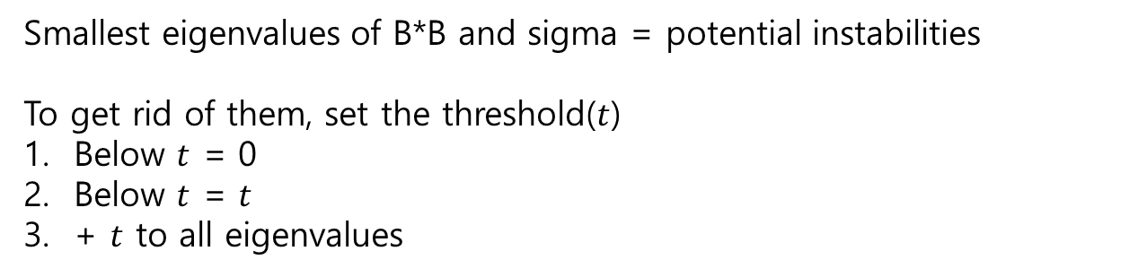
Encoding matrix inversions _
About SNR degradation
- It occurs when the elements of the inverted encoding matrix are large
cf. size of encoding matrix – it has something to do with the degree of linear independence
ex) When the sensitivities of any two component coils overlap too severely, different rows of the encoding matrix become nearly identical -> encoding matrix to become nearly singular(=ill conditioned) -> susceptible to noise amplification and random errors
$$B_{pseudo}^{−1}={\left(B^{∗}B\right)}^{−1}B^{∗}$$
$$= VΣ^{−1}U^{∗}$$
Smallest eigenvalues of B*B and sigma = potential instabilities
To get rid of them, set the threshold($t$)
Below $t$ = 0
Below $t$ = $t$
+ $t$ to all eigenvalues

